Slide 1

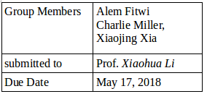
Neural Network & Deep Learning
(EECE680C) Project
“Retinal Optical Coherence Tomography
(OCT)”
Watson Graduate School of Engineering & Applied Science
Department of Electrical & Computer Engineering
GroupMember: Alem Haddush Fitwi, Charlie Miller, Xiaojing Xia
We did it collaboratively! We had a lot of meetings ftom start to end!

Slide 2
Outline/Content:
Introduction
II. Dataset
III . Architecture
IV. Shape of Data
V. Implementation
VI . Results and Discussion
VII. Conclusion
VIII. References

Slide 3
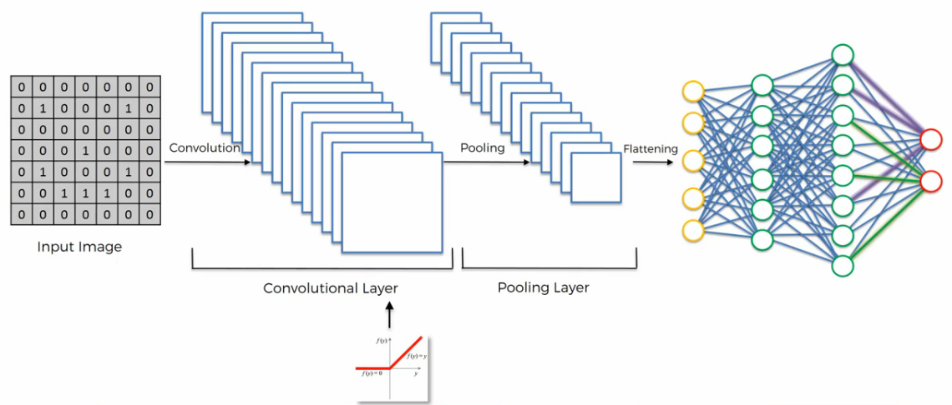
I. Introduction
Convolutional Neural Networks:
CNN is made up of neurons that have learnable weights and biases.
Best for gridded source data like image that allows to encode certain properties into the architecture.
Neurons arranged in 3 dimensions: width, height, depth.
The main layers/processes are:
- Convolutional Layer + Activation
- Pooling Layer
- Flattening
- Fully-Connected Layer
Fig-1: Basic Architecture of CNN

Slide 4
… Introduction
INPUT: holds the raw pixel values of the image.
CONV layer: computes the output of neurons that are connected to local regions in the input.
RELU layer: activation function
POOLING layer: performs a downsampling operation along the spatial dimensions(width, height)
Fully Connected layer: computes the class scores
Fig-1: Basic Architecture of CNN

Slide 5
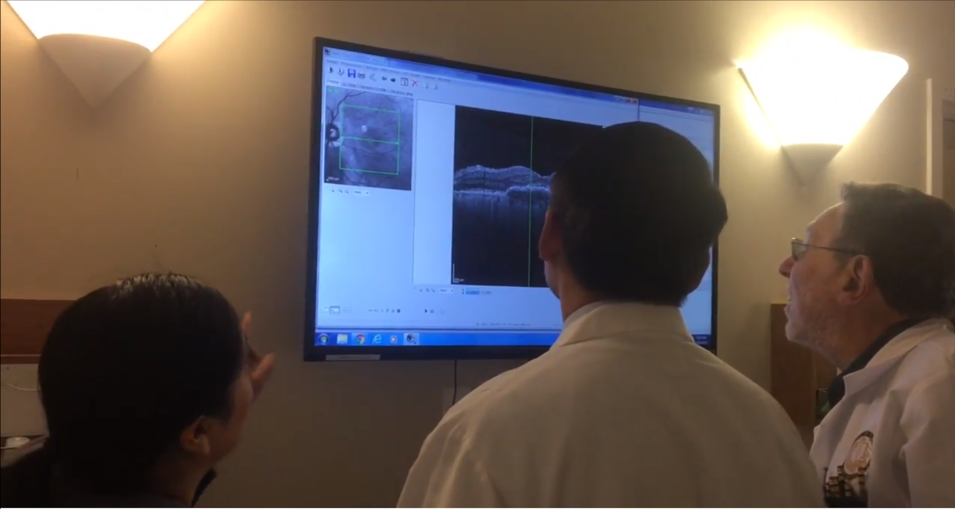
II. Dataset - Motivation
Background:
Diabetic macular edema (DME) and Choroidal Neovascularization (CNV) associated with age-related macular degeneration (AMD) are the leading causes of vision loss in the industrialized world.
Without prompt medical innervation, many will experience universal vision problems.
Many people with these diseases are under the condition to access to specialist for training.
At the same time, many in undeveloped urban areas cannot find a quick treatment due to high patient volume. A Doctor is not everywhere.
Low cost
Convenient
It effectively classified images for macular degeneration and diabetic retinopathy
It also accurately distinguished bacterial and viral pneumonia on chest X-rays
This has potential for generalized high-impact application in biomedical imaging
Fig-2: Analyzing Retina Image

Slide 6
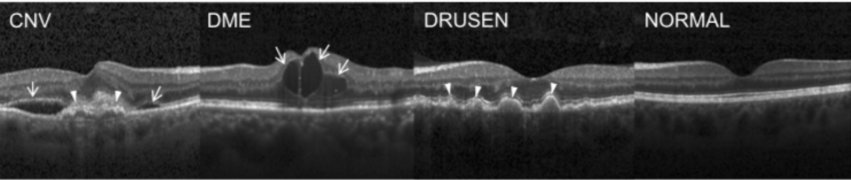
... Dataset
Retinal optical coherence tomography (OCT) - Scans of Retinas
30 million performed each year
4 classes - NORMAL, CNV, DME, DRUSEN (AMD)
84,452 images labeled by experts
Distinguishing features indicated by arrows
Fig-3: The four classes of Retina OCT Images

Slide 7
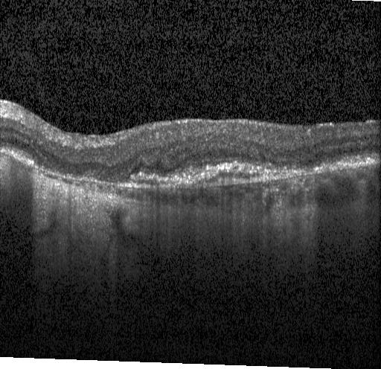
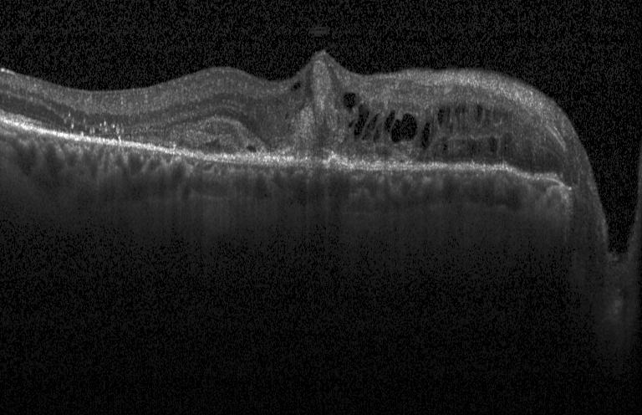
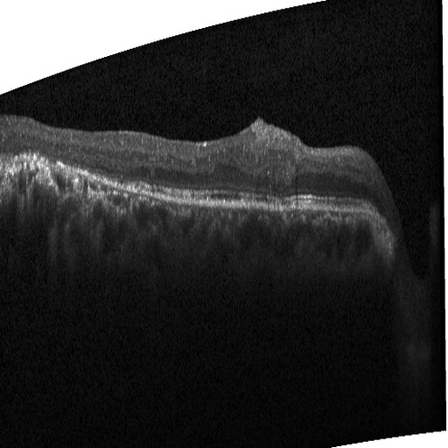
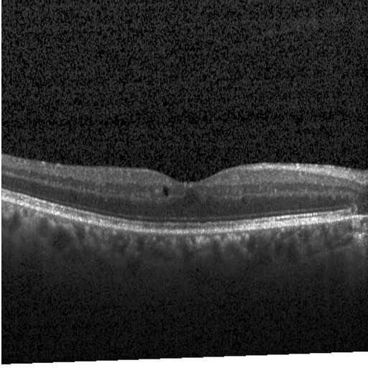
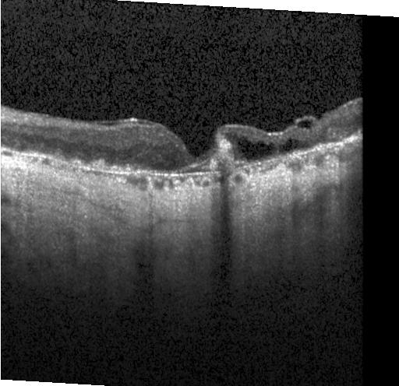
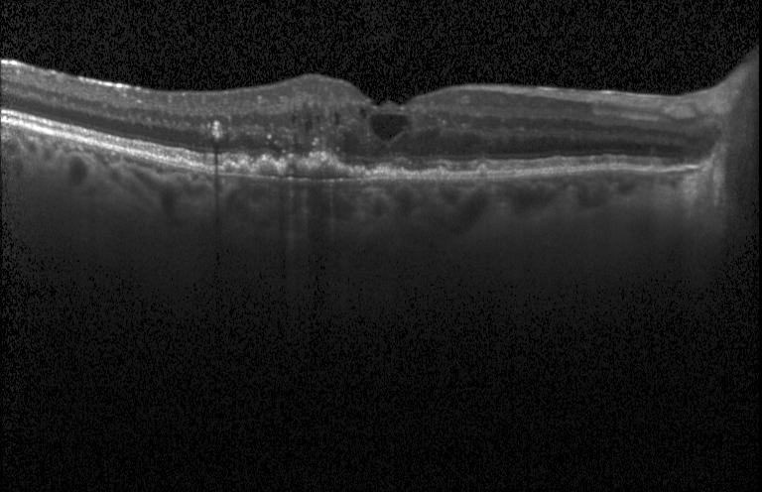
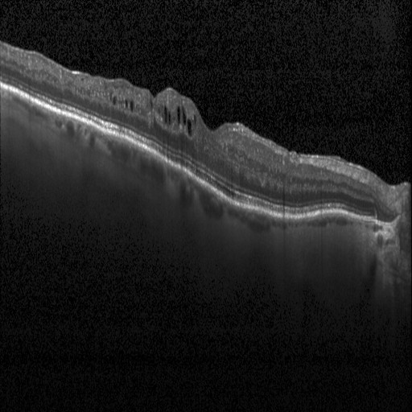
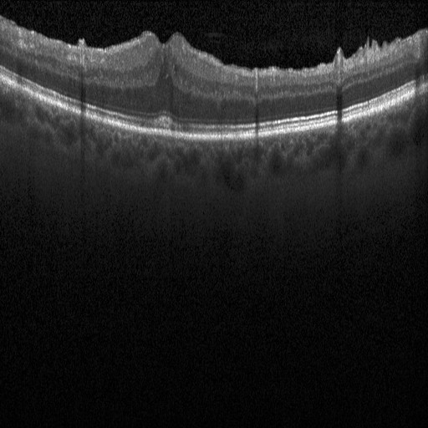
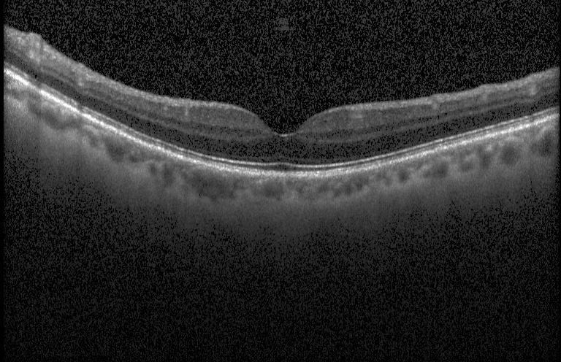
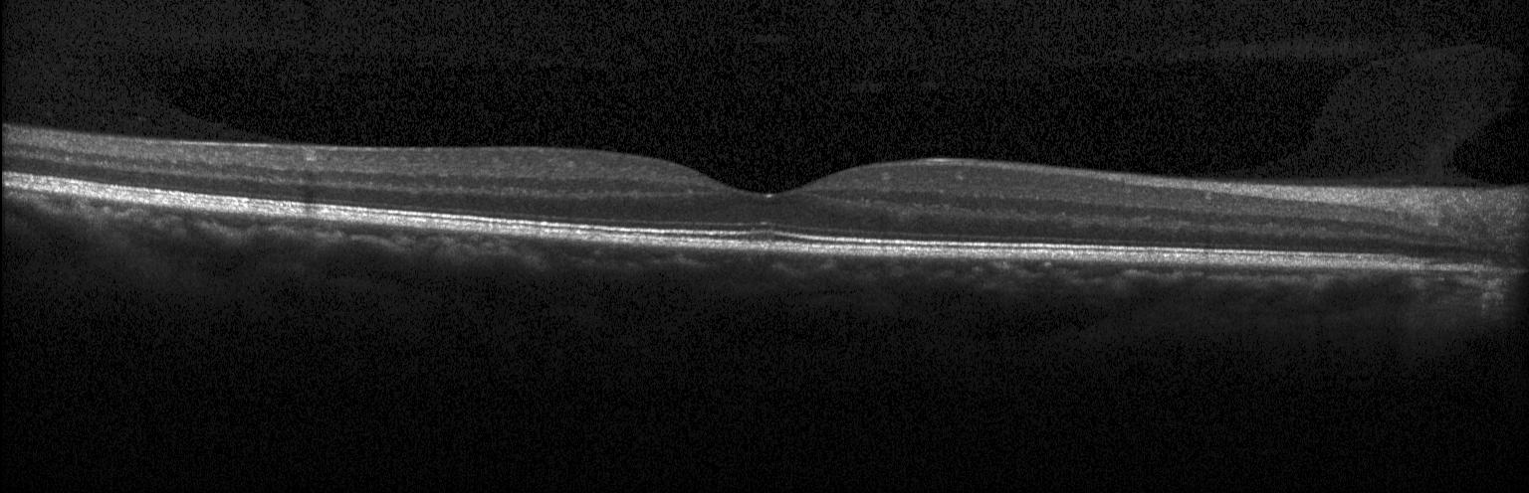
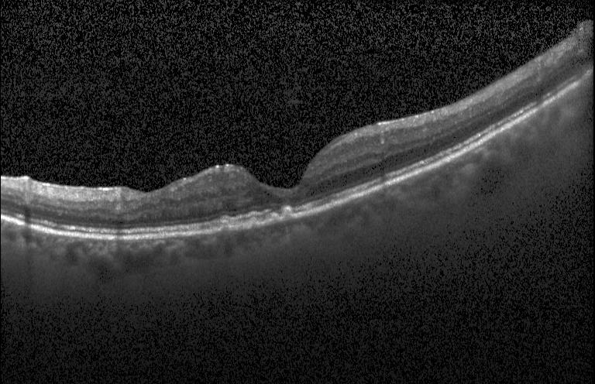
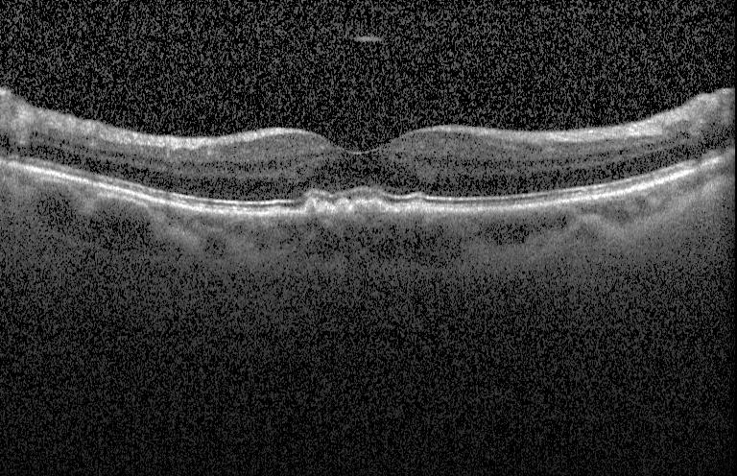
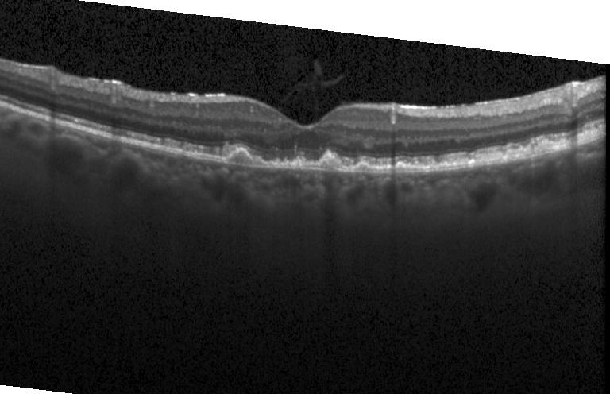
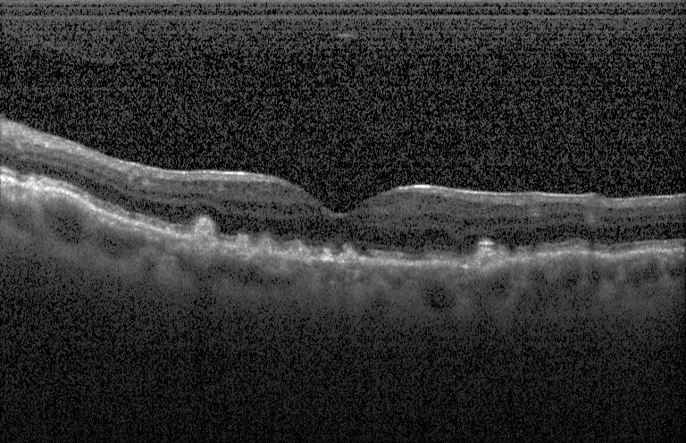
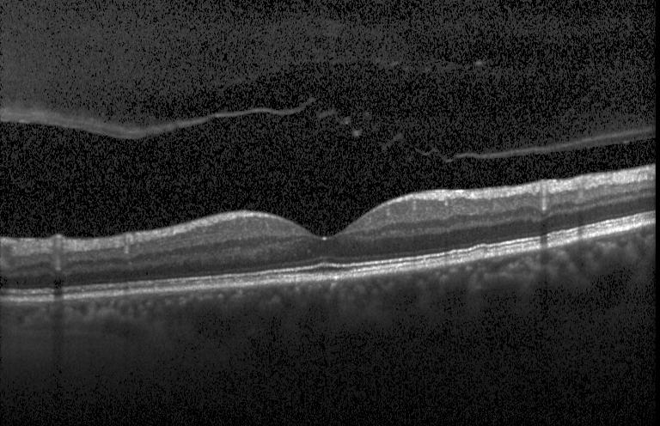
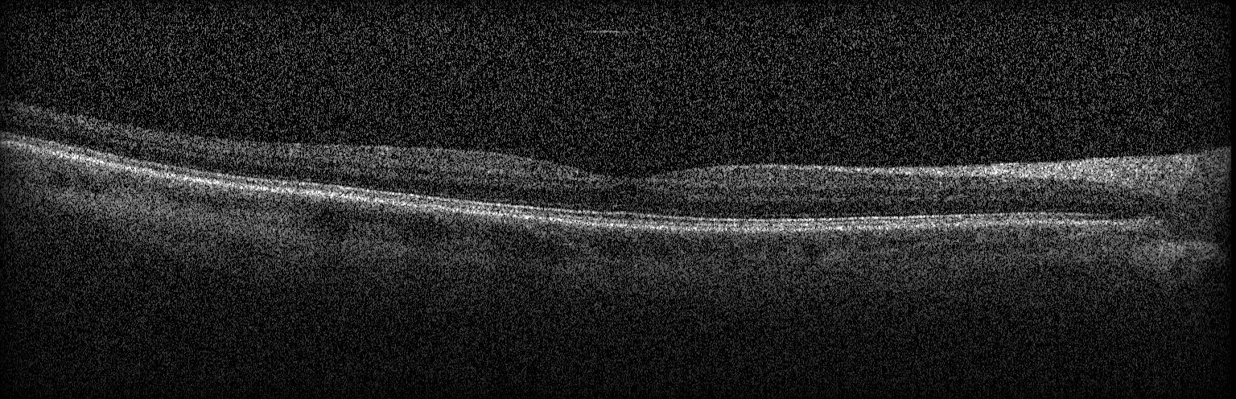
... Dataset
→ Examples of Each Class (Irregular Shapes)
4 CNV Images: Build-up in the middle and holes on the sides
4 DME Images: Holes in the middle
4 DRUSSEN Images : small bumps in middle
4 NORMAL Images: No irregular features
Fig-4: Examples of each class image

Slide 8
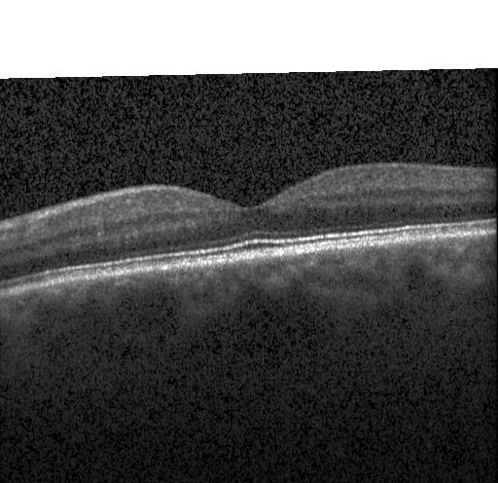
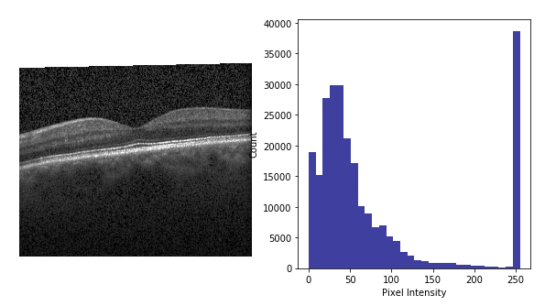
... Dataset
Example Image
Histogram of image shown bottom right
Shows count of pixels per intensity (0-255, white being the brightest)
Most entropy found in the 25 - 100 intensity
CNN is most sensitive to these values
Example Normal Retina image
Fig-5: Image Histogram

Slide 9
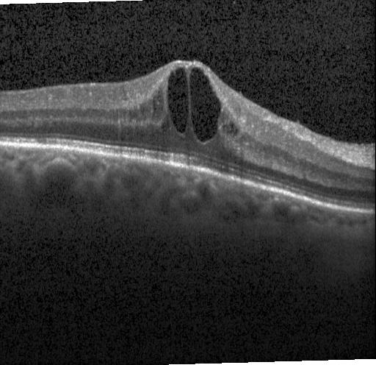
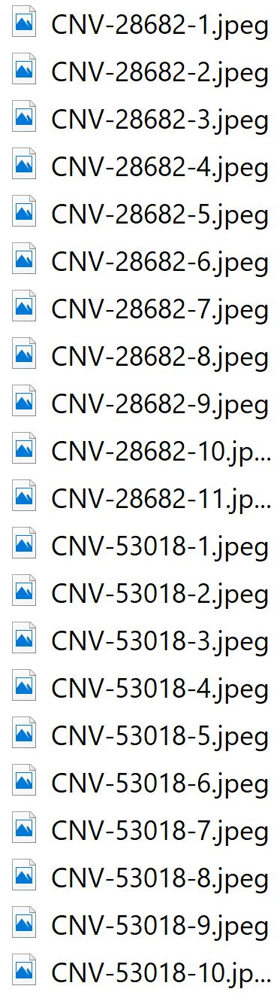
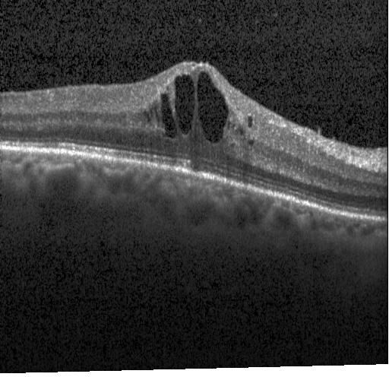
... Dataset
Dataset Structure
Each category has sub-groups
Images are grouped together by a 6-digit number
Images in same group look similar
Our first dataset did not take this into consideration
In final dataset, we took 2057 images from each class
We took 1 to 4 from each subgroup
Images more varied this way
Images of same group in blue box
2 distinct group images indicated by red box
Fig-6: Similar images -
same patient

Slide 10
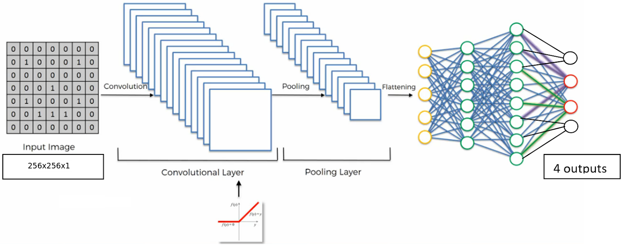
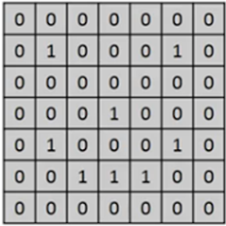
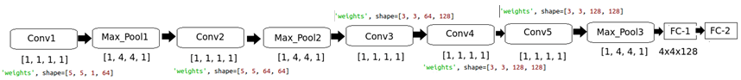
III. Architecture
Fig-6: Our CNN Architecture

Slide 11
... Architecture
Image Size=256x256 (grayscale)
Test Images: 968
Training Data: 83,484
Our Architecture Comprises
> 5 convolutional layers of Kernel=[1, 1, 1, 1]
> 3 Max_pooling Layers of Kernel=[1, 4, 4, 1]
> 2 Fully Connected Layers of 384 and 192 neurons
All of the above hyperparameters were determined after many attempts or trainings.
These hyperparameters and corresponding weight shapes give the best results of all attempts we made.

Slide 12
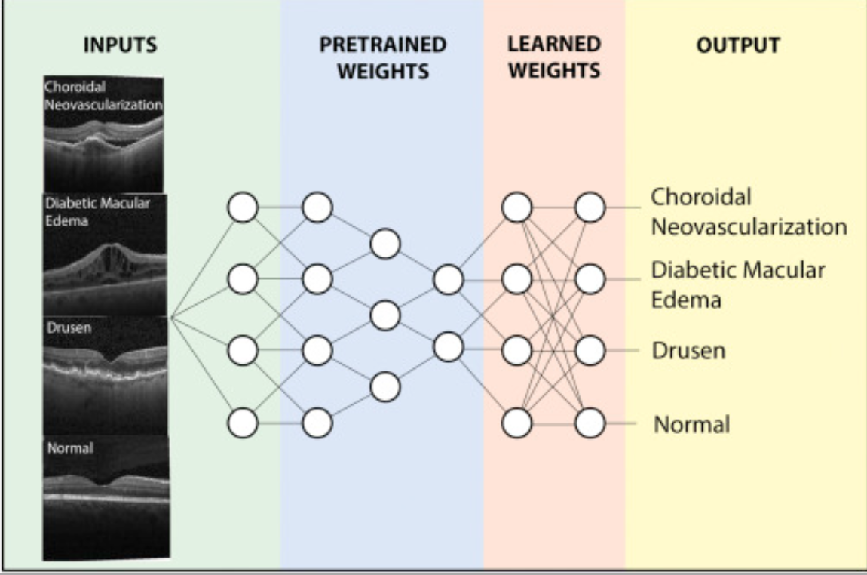
... Architecture
Fig-7 is the architecture that was used by the people who developed these dataset. They used a transfer Network.
They didn’t develop their own DL Architecture. Rather, they used a transfer network to make their input dataset suitable to google net.
Fig-7: This is their model

Slide 13
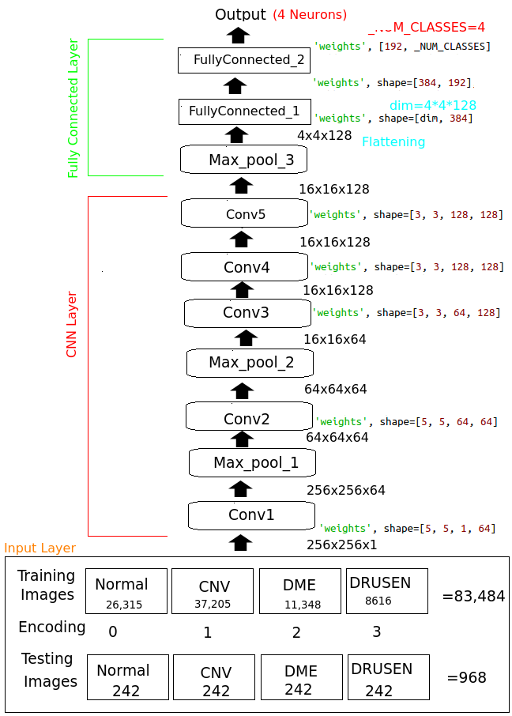
IV. Shape of Data
After a number of trainings using various settings, we have settled on the following parameters that gave us very good result:
INPUT Shape = [256x256x1] → Image size is reduced to 256x256 to reduce the computational time.
CONV layers: each computes a dot product between their weights and a small region they are connected to in the input volume. Conv1 & 2 Use 64 filters, Conv3, 4, & 5 use 128 filters for each.
Max Pooling layer: performs a downsampling operation(4x4) , kernel=[1,4,4,1]
Filter sizes of conv1 → [5 5 1 64], Conv2 → [5 5 64 64], and filter sizes of Conv3 , Conv4, & Conv5→ [3 3 64 128] were adopted after many attempts.
They happened to give us the best results. Previously we tried [1 2 2 1] size filters, but the training was too slow.

Slide 14
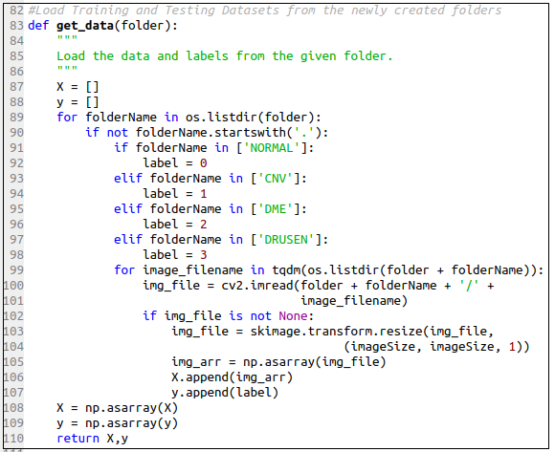
V. Implementation/Coding
The most important parts of our python program are hereunder briefly presented.
This method reads and loads the training and testing images from the folders they are placed and encodes them as per the class they belong to. There four classes of images namely:
Normal encoded as 0
CNV encoded as 1
DME encoded as 2
DRUSEN encoded as 3

Slide 15
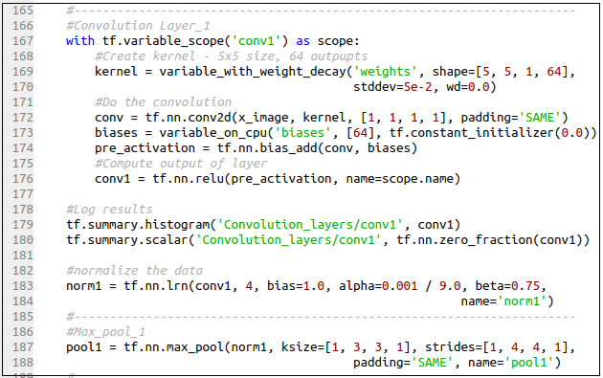
...Implementation/Coding
The first convolutional and Max_pooling ayers

Slide 16
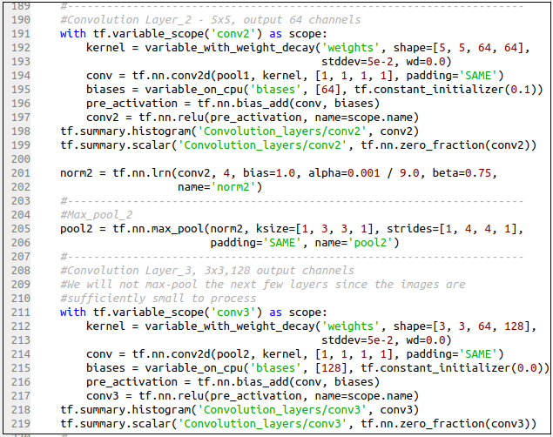
...Implementation/Coding
Conv2, Max_pool_2, and Conv3

Slide 17
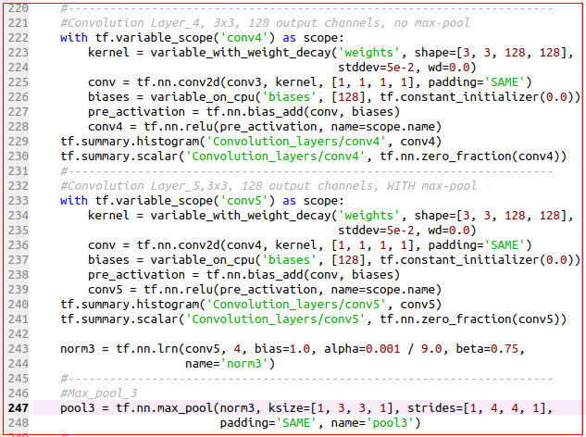
...Implementation/Coding
Conv4, Conv5,
and
Max_pool_3

Slide 18
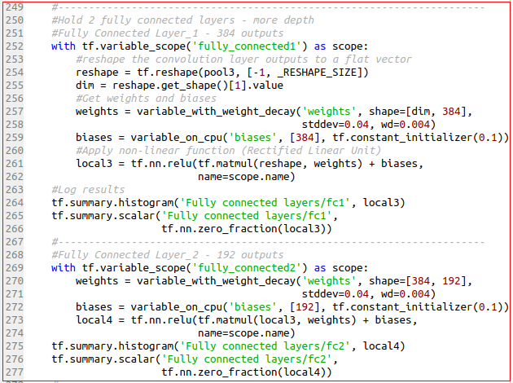
...Implementation/Coding
Fully connected
layers 1 and 2

Slide 19
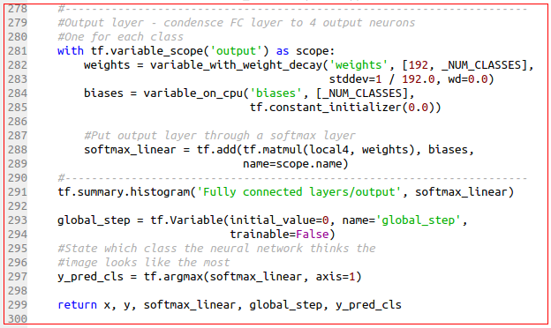
...Implementation/Coding
Output Layer

Slide 20
VI. Result and Discussion
Before finding the best architecture, we have made a number of different settings and trainings.
We start with a simple architecture comprising two conv layers and one Max pooling layer → but the performance was very poor.
Then, we trained an architecture comprising 4 convolutional layers and two Max pooling layers. But we were not pleased by the performance yet.
Eventually, we adopted a deeper architecture or model comprising 5 convolutional layers and three Max pooling layers that gives a very good performance.

Slide 21
… Result and Discussion
Due to the bigger image size (typically 512x496 and 168x512 and too many images (more than 85 thousands of images) of the dataset, performing the training using our laptops or machines was next to impossible.
We had to do a lot of analysis and input preprocessing to come up with a reduced representative dataset that could be effectively trained using our model.
Then, we settled at a reduced dataset of 8,228 for training and 300 for testing.
We did our training and testing for a reduced dataset on Google Colaboratory.

Slide 22
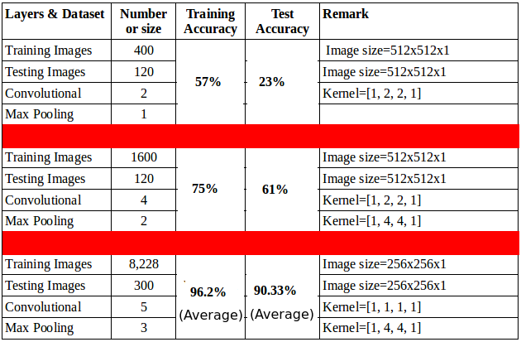
… Result and Discussion
The table on the right side portrays the results we collected for various settings on Google Colaboratory that led us to the final and stable model that can do classification with an accuracy of 90% to 96%

Slide 23
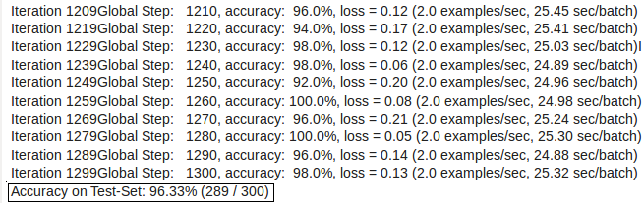
… Result and Discussion
Here is a snapshot of our result as run on Google Colaboratory
Test result at 1300 iterations

Slide 24
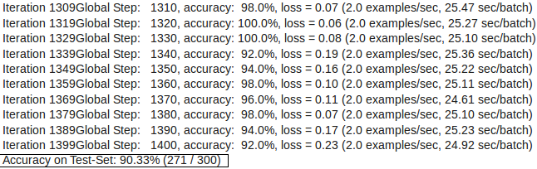
… Result and Discussion
Here is a snapshot of our result as run on Google Colaboratory
Test result at 1400 iterations

Slide 25
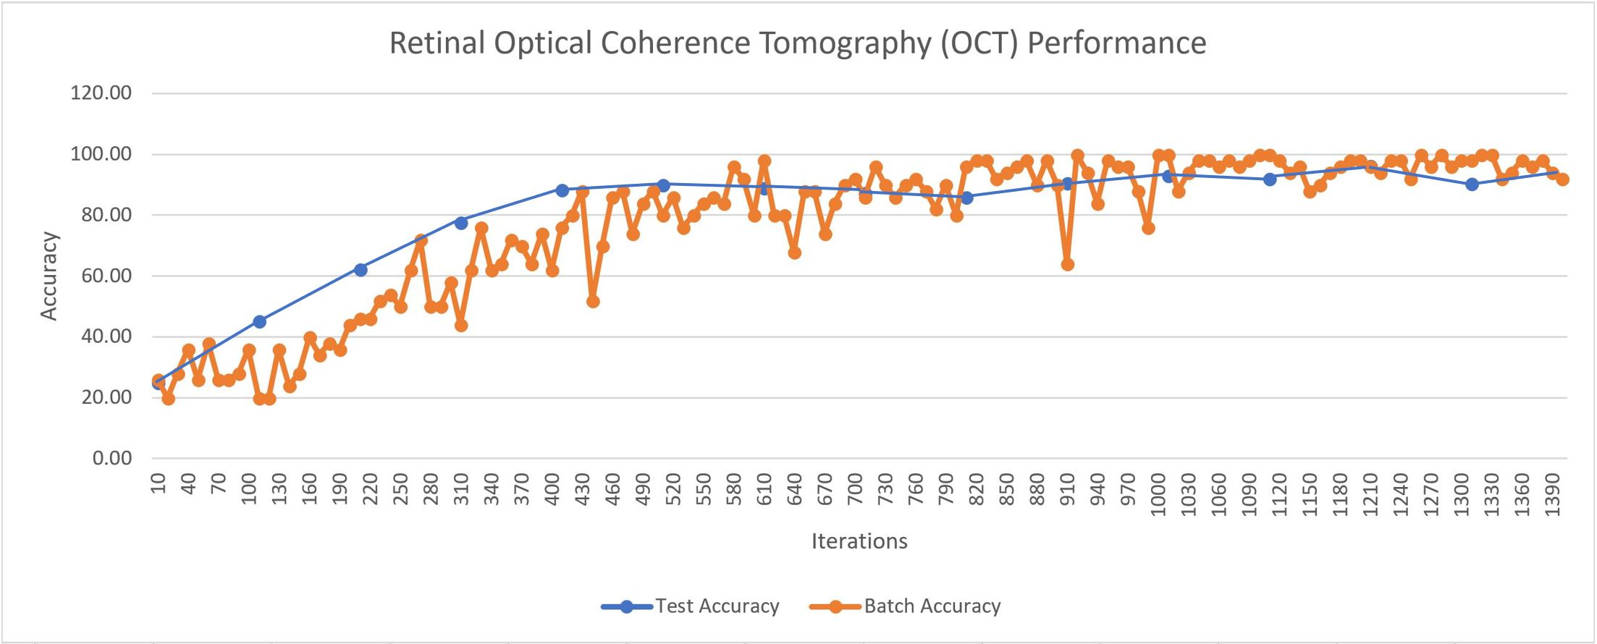
… Result and Discussion
Graphical depiction of the training and testing performance of our CNN model
(%)

Slide 26
VI. CONCLUSION
Due the facts that the dataset comprises too many Retina OCT images (84,452) of irregularly larger size (some 496x512 and others 768x512), doing the training and determining the optimal hyperparameters were very challenging for us for we limited computing resources.
But after doing a great deal of analyses on the dataset and the apropos hyperparameters, we have managed to come up with a CNN model that can effectively classify the Retina OCT images with an accuracy of 90% to 96%.
We did all our trainings and testings on Google Colaboratory with reduced image size (256x256) and reduced but representative dataset (8,228)

Slide 27
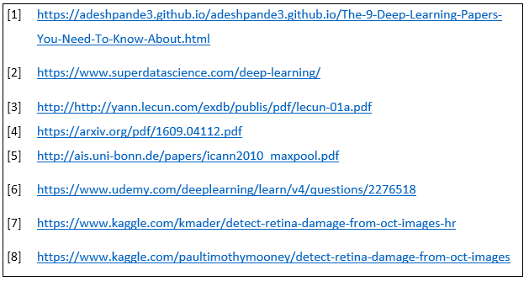
VII. References

Slide 28
THANK YOU！

